Slide 1
Seamless IoT Device Integration with “IoT MonitorX” Platform
Presents to Mr. Piyawat Jomsathan and Dr. Sanit Arunplod
Prepared by: Abir Ahmed

Slide 2
Objective
Real-time monitoring from “IoT MonitorX” platform using IoT sensor devices.
Control IoT devices remotely using Web/Mobile Application.
Develop secure and reliable data transmission system between server and end devices.
Test Case: Monitor Room Temperature and Humidity; Control LED (Considering as AC switch)

Slide 3
Overall Development Process
MQTT Protocol
Web Application
End Device
Server
DHT22
Subscribe
Dashboard
MQTT Protocol
Publish
ESP32
Publish
Control Switch
Subscribe
LED
Figure 1: End Device System Integration Process

Slide 4
Development Methodology
Hardware Setup
1. Connect DHT22 with ESP32 GPIO pin
2. Connect LED with ESP 32 GPIO pin
Firmware Development
1. Develop Wi-fi setup, MQTT integration, Publish and Subscribe Code
2. Create .h and .cpp file from the code and make .zip file to develop a library
Firmware Upload
1. Add the library as .zip file to the Arduino IDE.
2. Write Basic Code to Call setup and run function from library.
3. Upload the code to ESP32
Integration with Server
Real-time Testing
1. Create a New Project on Server
2. Add Devices -> Add Gauge/Charts and Subscribe to the topic to show values.
3. Add Devices ->Add Switch and publish to the topic to control LED
1. Check the real-time data in Arduino IDE and compare with the result on dashboard.
2. Control the switches from Application and check immediate effect on LED.

Slide 5
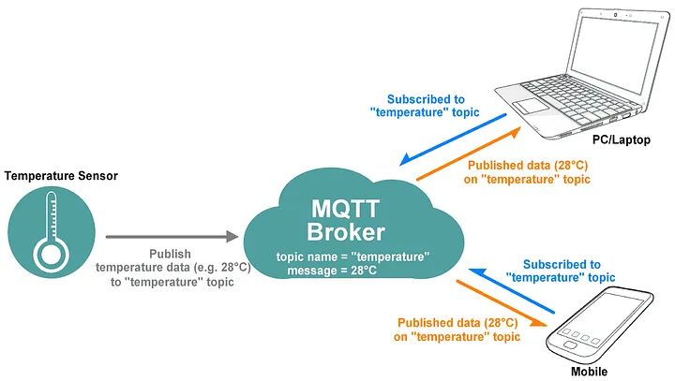
Technology Stack (MQTT)
MQTT is a standards-based messaging protocol.
Used for machine-to-machine communication.
MQTT supports messaging between devices to the cloud and the cloud to the device.
Well-supported
Principles of the publish/subscribe model
Scalable
Reliable
Secure
Broker handles the communication between publishers and subscribers
Well-supported
Figure 2: MQTT Protocol

Slide 6
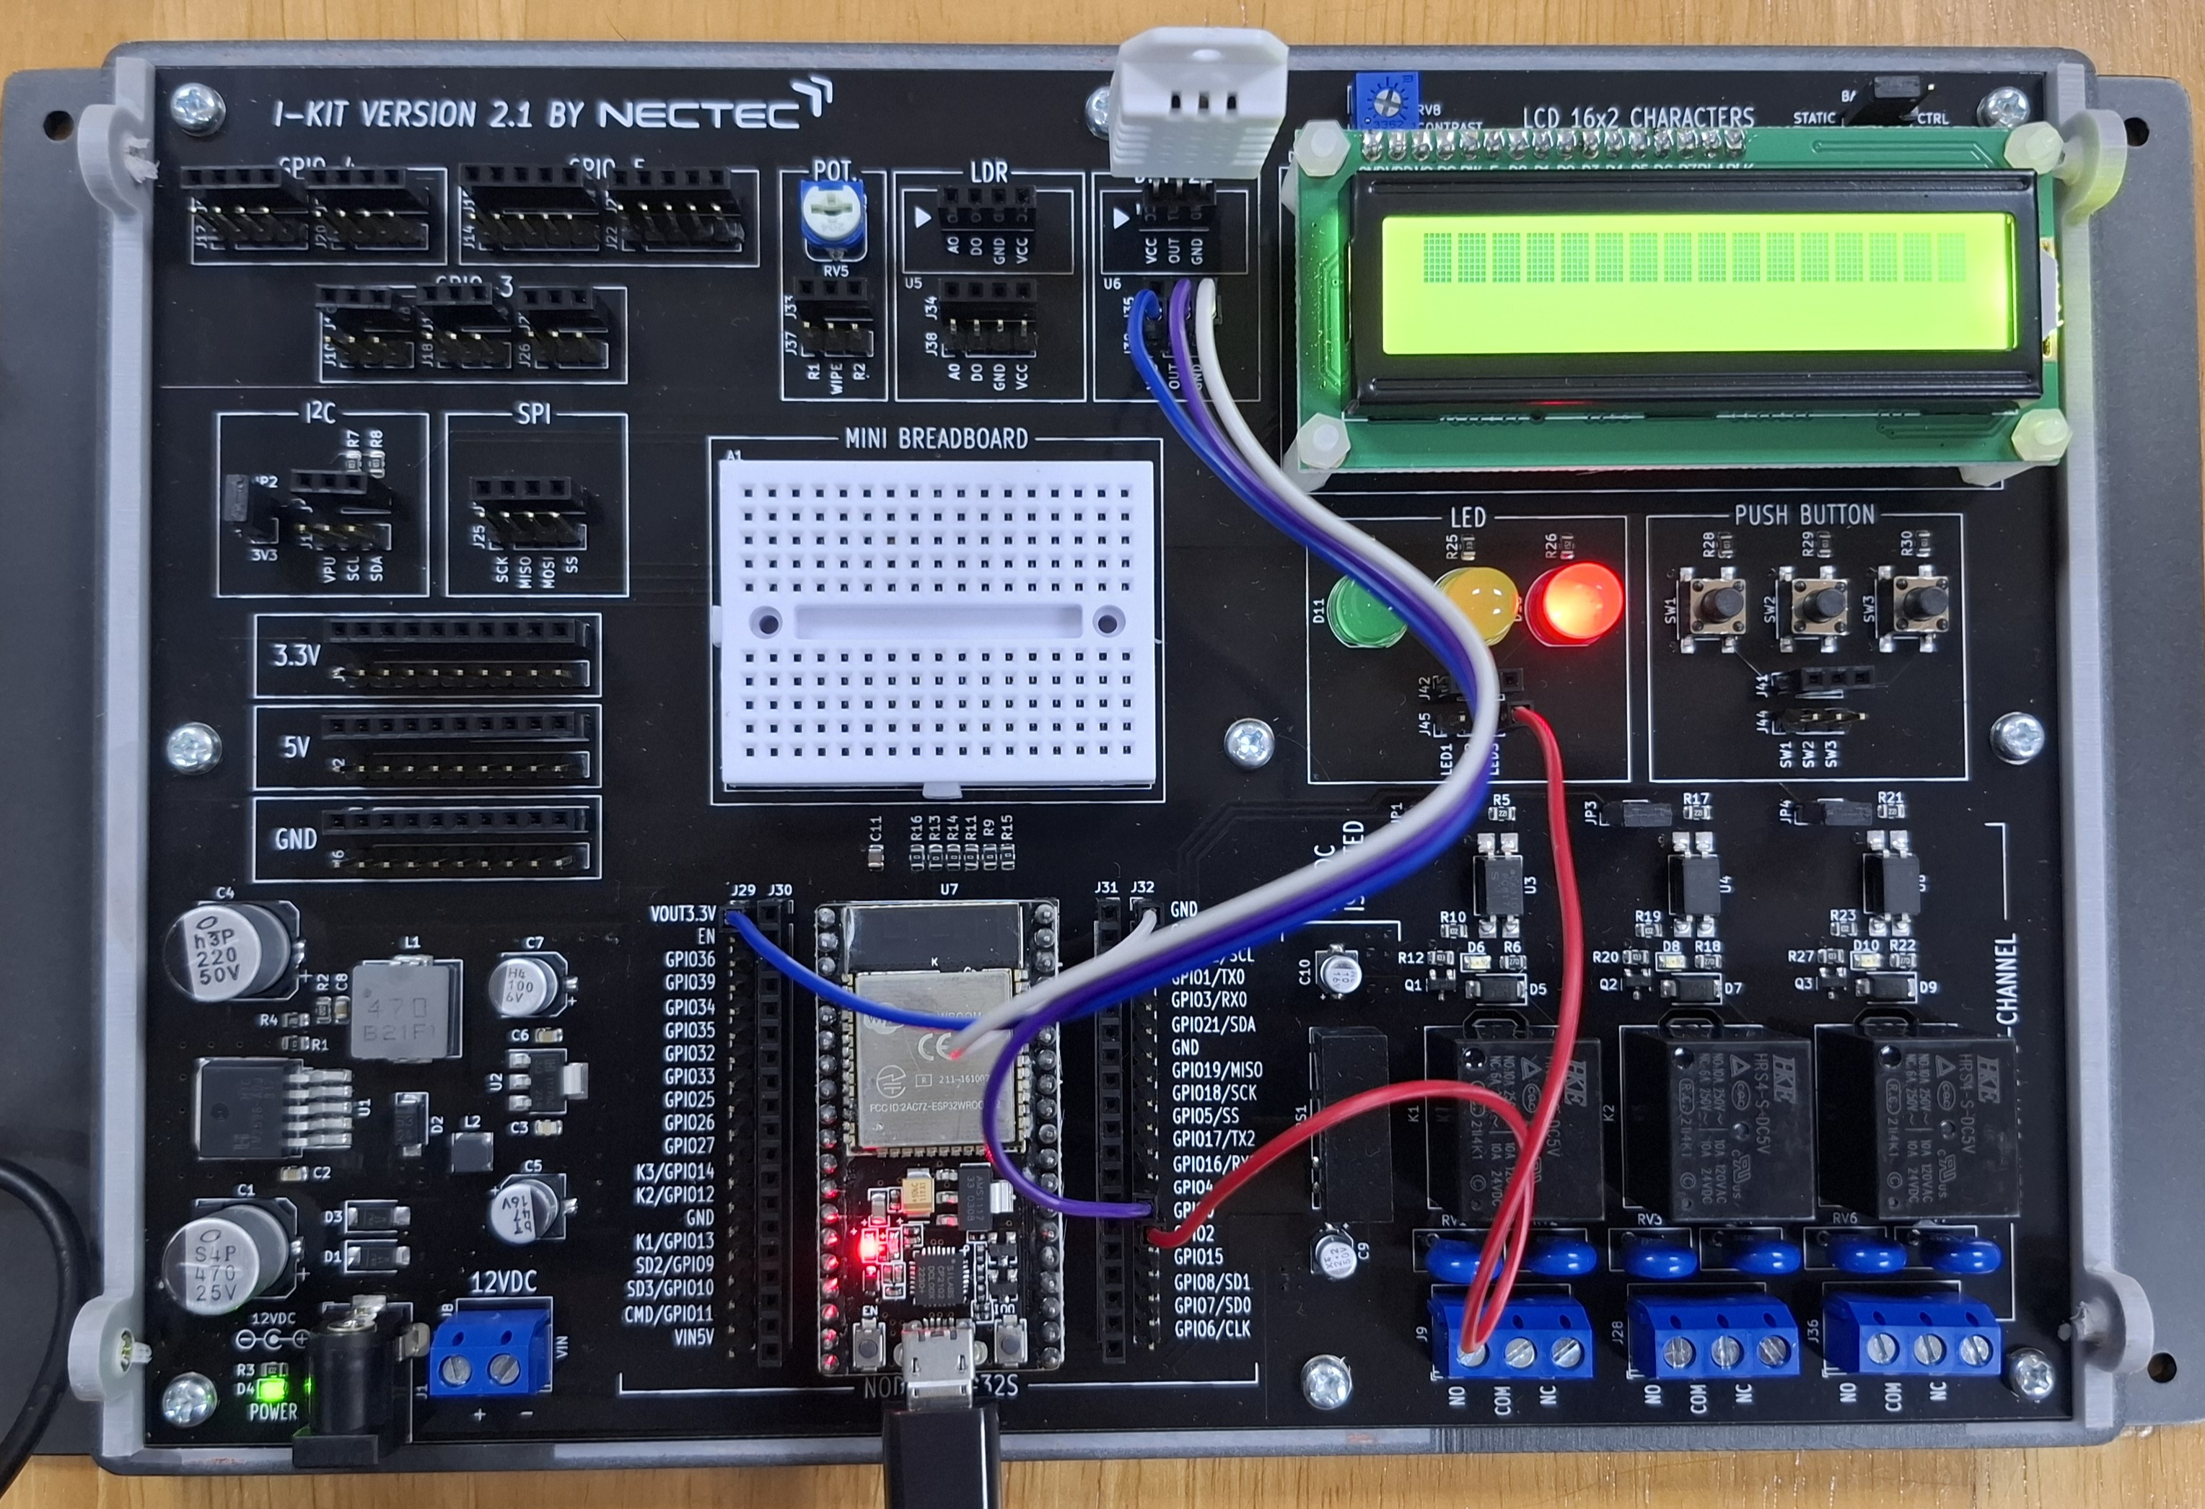
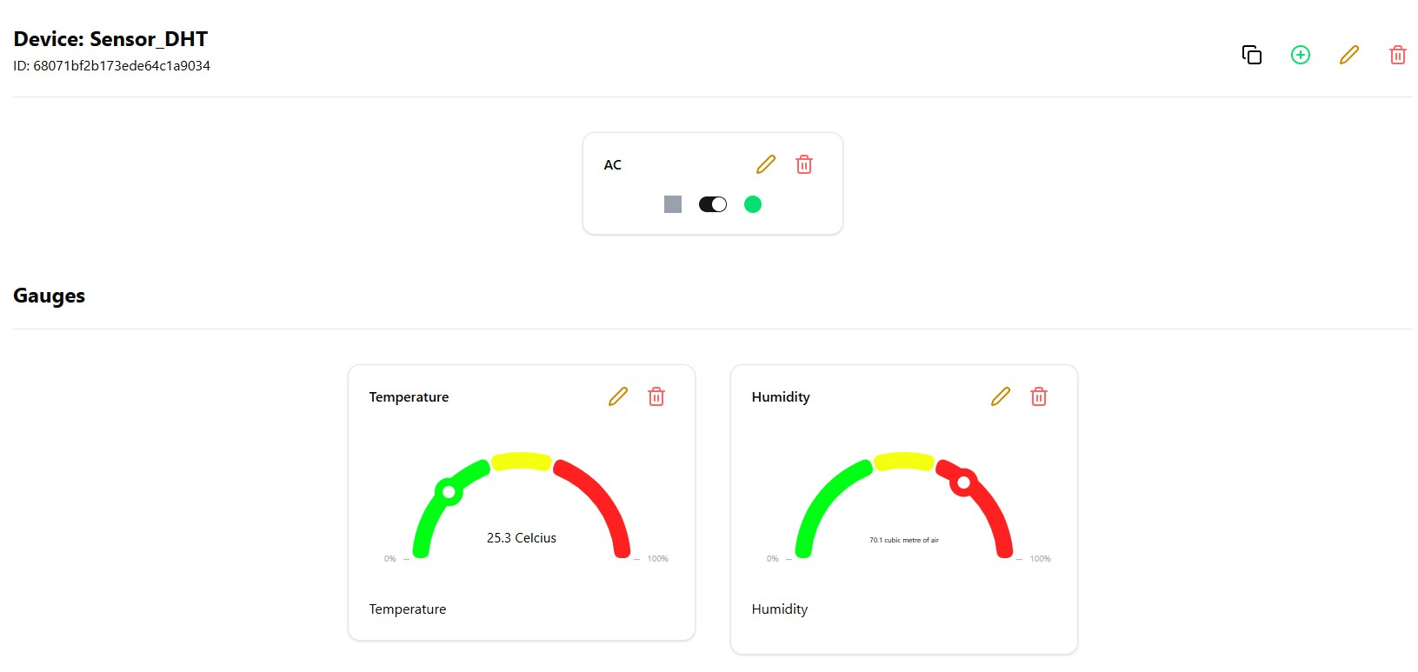
Demonstration
DHT22
DASHBOARD
CONTROL
MONITOR
ESP32
Hardware
Software
Figure 3: Project Demonstration

Slide 7
THANK YOU

